Slide 1
Meeting #3
- The three generations of sequencing technologies
- FASTQ format, quality control
- Genome assembly

Slide 2

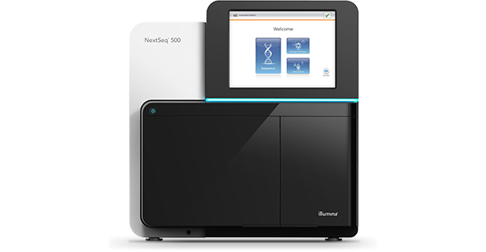
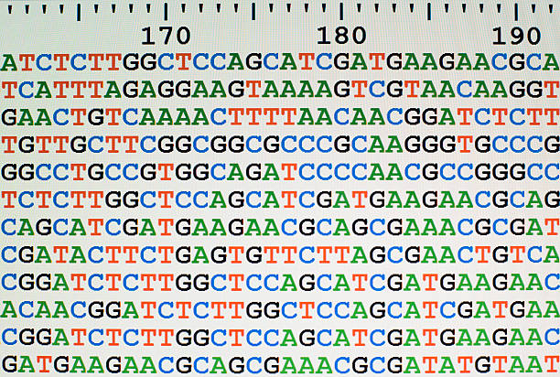
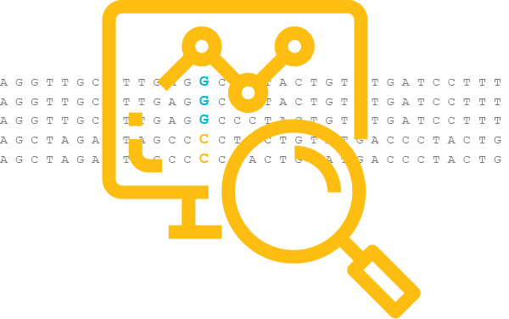
Sequencing is the process of reading DNA/RNA sequence

Slide 3
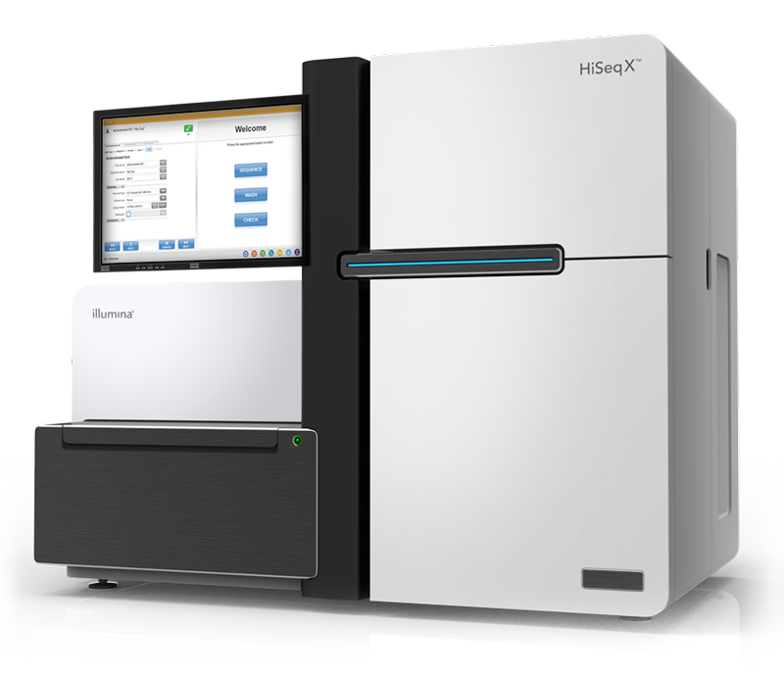
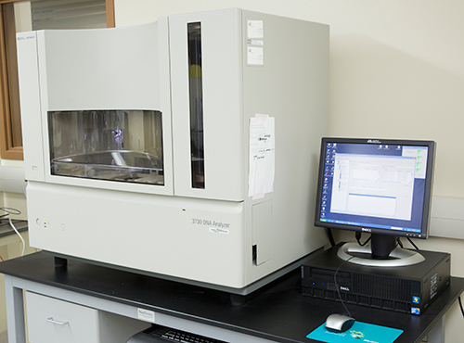
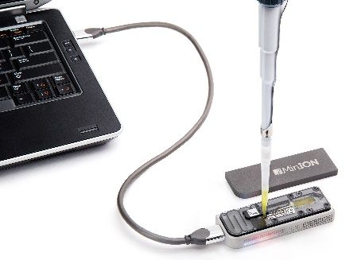
Sequencing technologies
1st generation
2st generation/Next generation
3rd generation
500-1000 bp fragments
50-500 bp fragments
>10 kb fragments
Short read sequencing
Long read sequencing

Slide 4

Sequencing by synthesis
DNA polymerase is protein (specifically – an enzyme) that builds a DNA strand (polymer) based on complementary rule, using the other strand a template

Slide 5
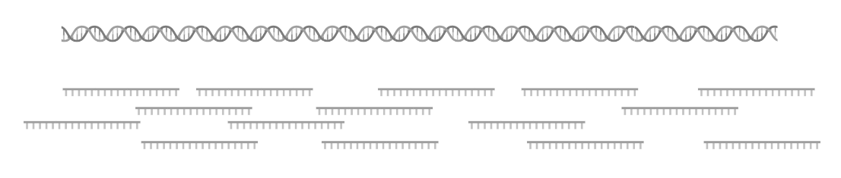
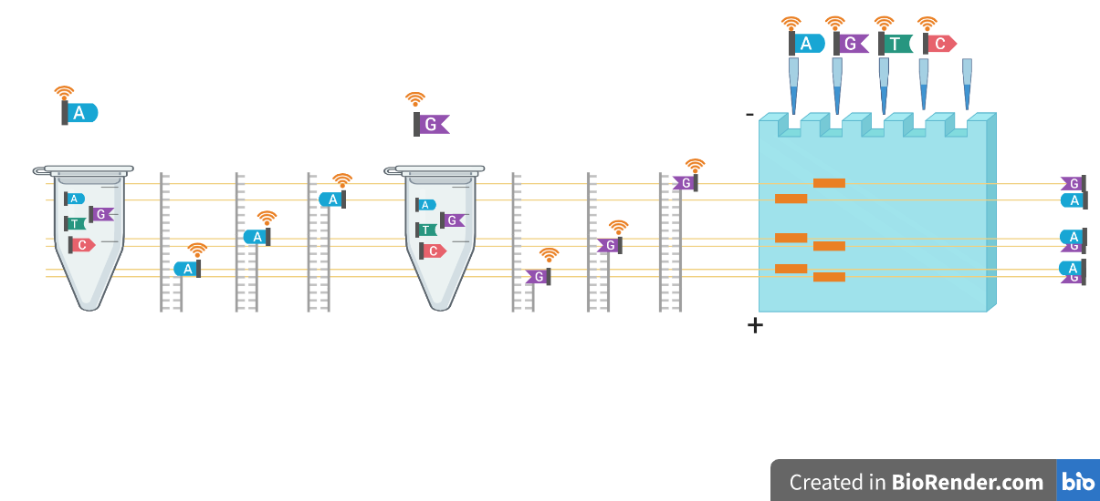
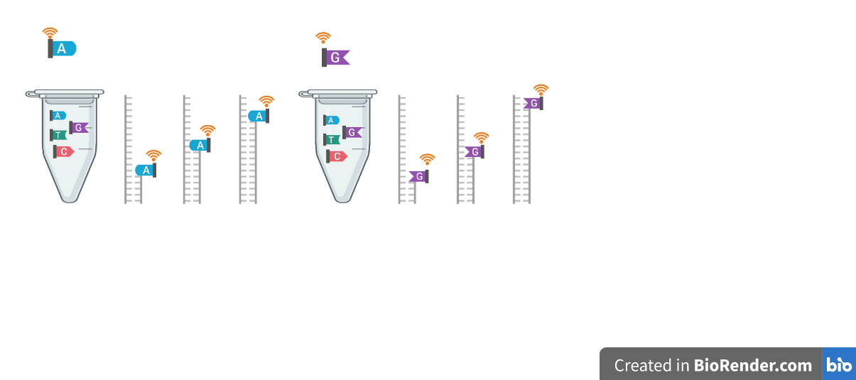
1st generation sequencing

Slide 6
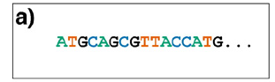
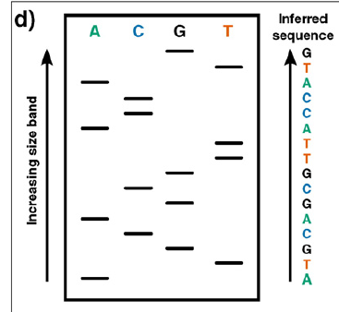
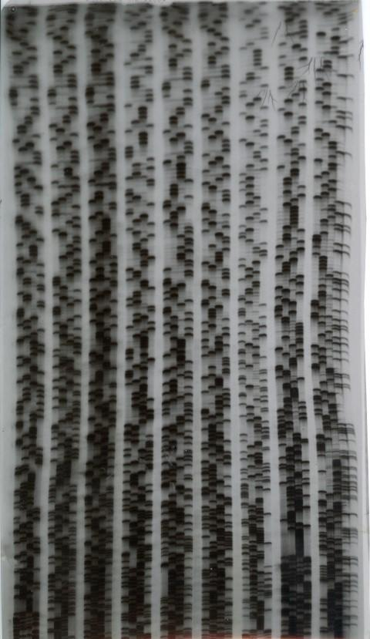
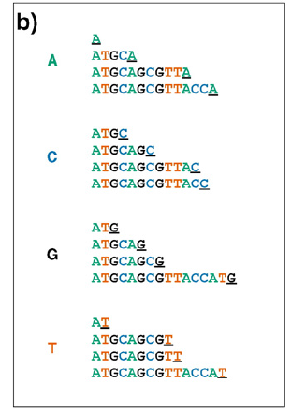
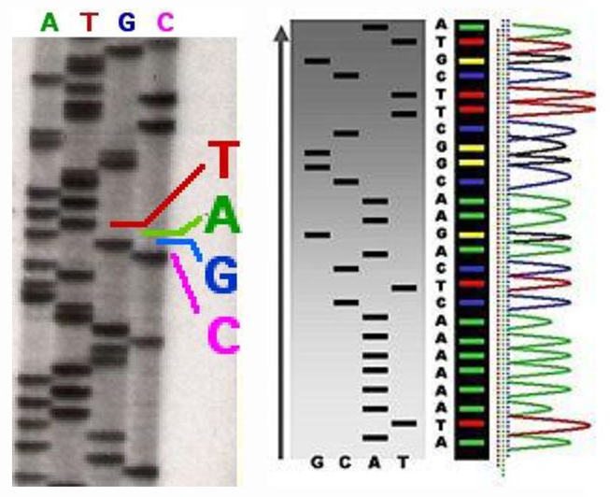
1st generation sequencing
Reads less than < 1kb in length

Slide 7
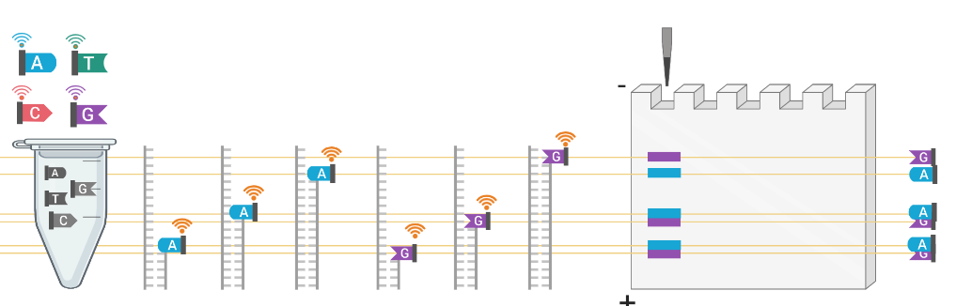
1st generation Sanger sequencing (optimization)
Fluorophores help performing the 4 different reactions in the same tube, as each nucleotide will emit a different color and they all can be visualized together.
This optimization helps to sequence a few samples at the same time (next slide).

Slide 8
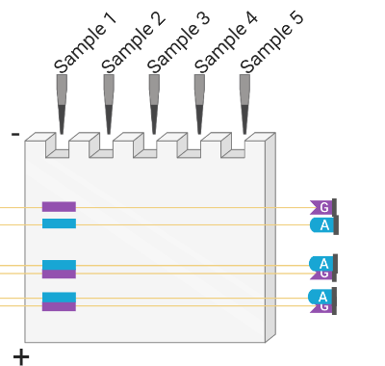
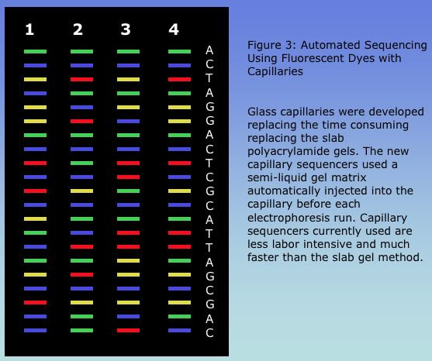
1st generation sequencing (optimization)
Radiolabeling -> fluorometric detction (4 tubes -> 1 tube)
Capillary based electrophoresis
Automated machines
Simultaneous sequencing of multiple samples

Slide 9
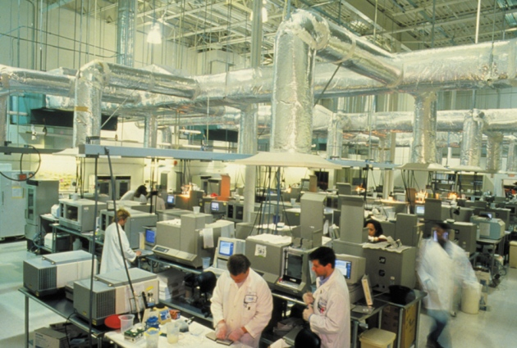
Human genome project
1990-2003
$ 3.8 bln
Enhancements:
PCR (in vitro cloning)
Recombinant DNA technologies
More efficient DNA polymerases
Newer sequencers allowed for simultaneous sequencing of multiple samples

Slide 10
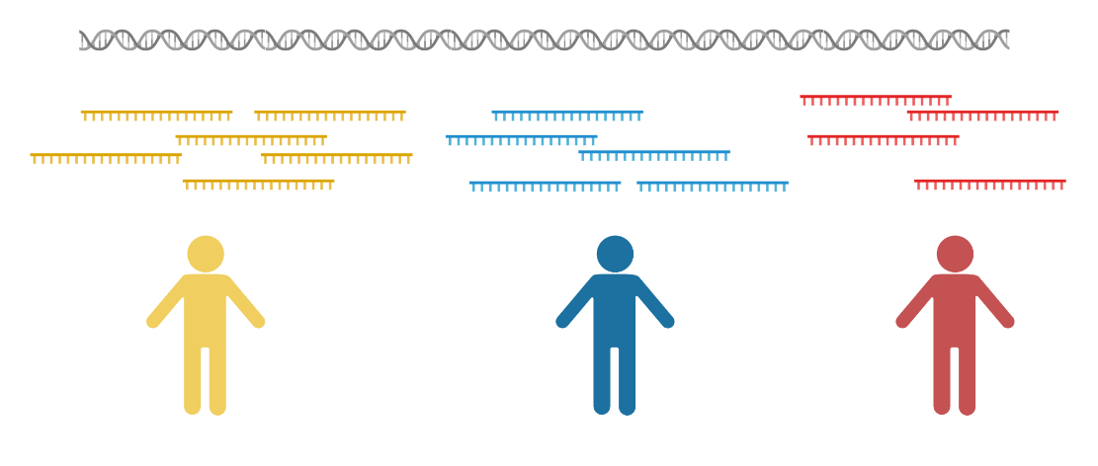
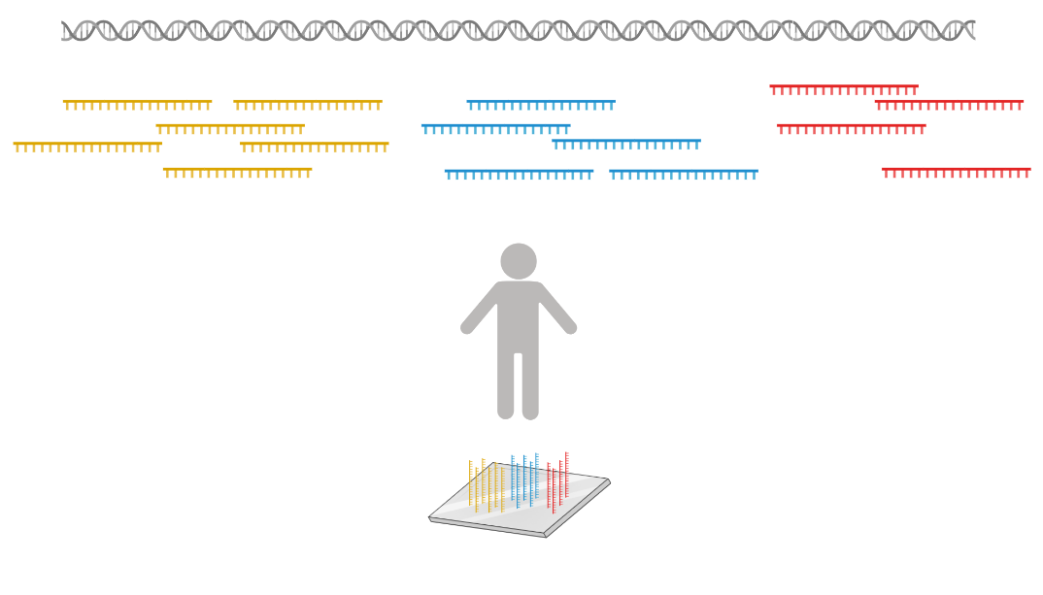
Massive parallelization in 2nd (next) generation sequencing (NGS)

Slide 11
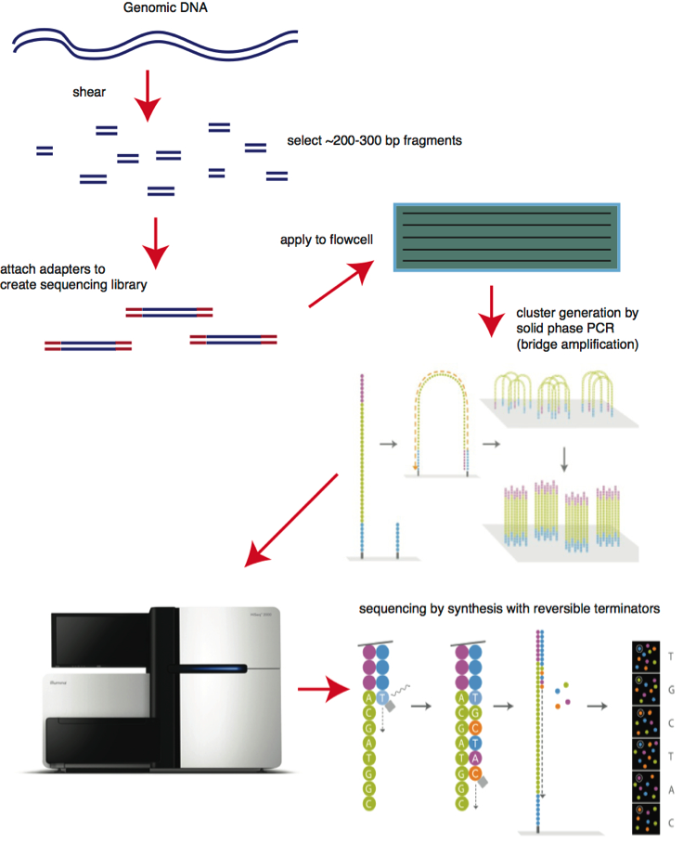
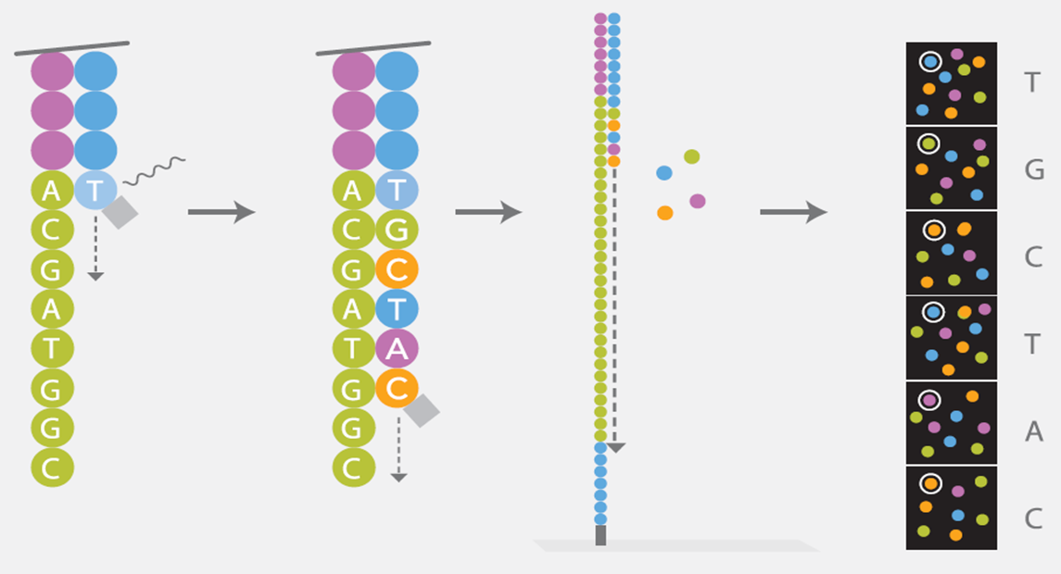

Next generation sequencing
https://youtu.be/fCd6B5HRaZ8?t=135&end=189
https://youtu.be/fCd6B5HRaZ8?t=55&end=77

Slide 12
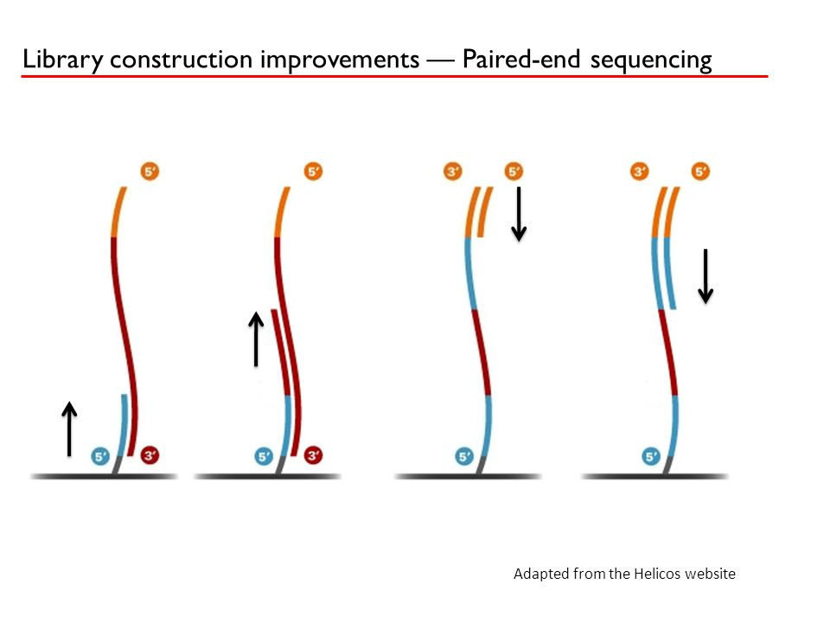
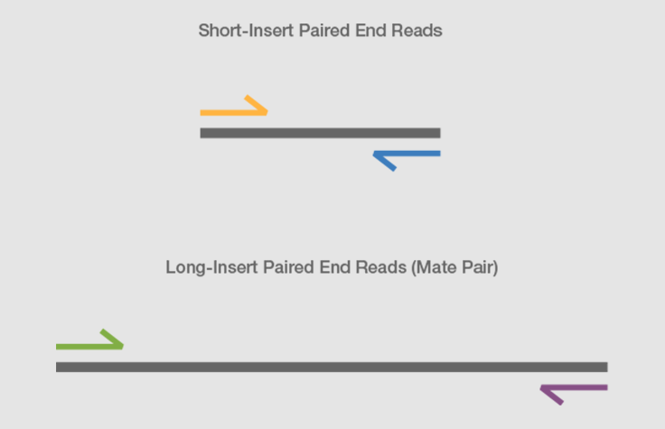
Paired-end sequencing
sequencing of one end of the original DNA fragment, followed by the other end
https://youtu.be/fCd6B5HRaZ8?t=188&end=250

Slide 13
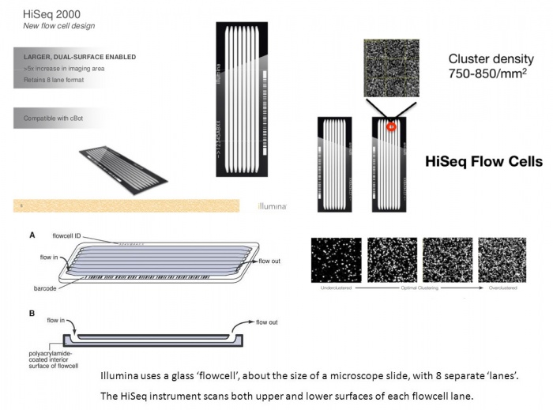
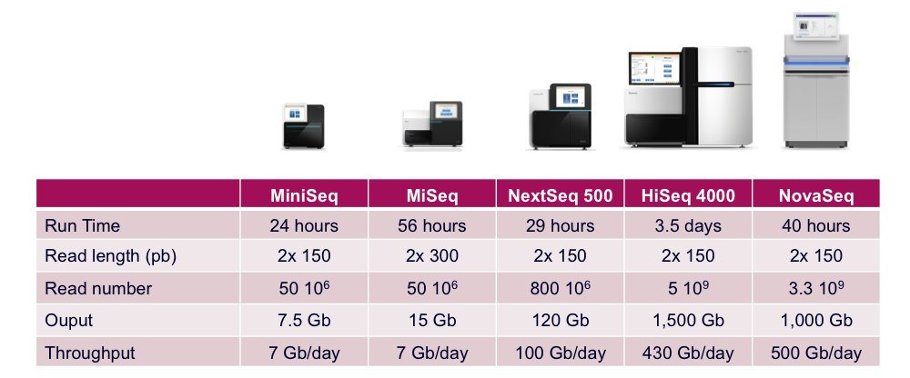
Illumina machine comparison

Slide 14
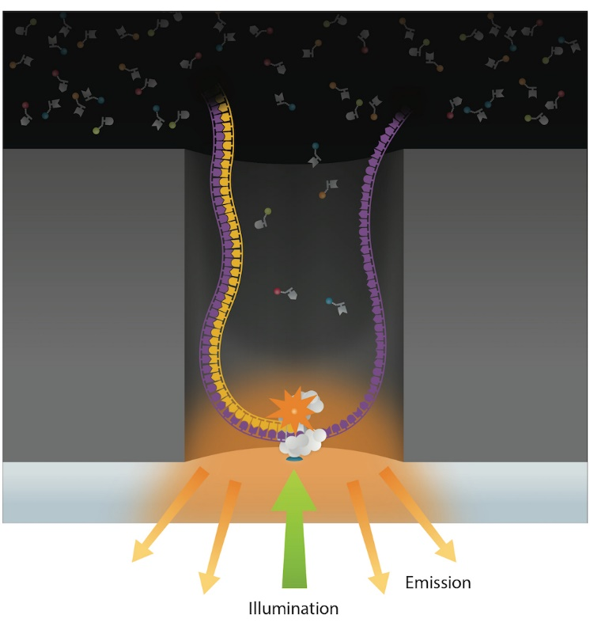
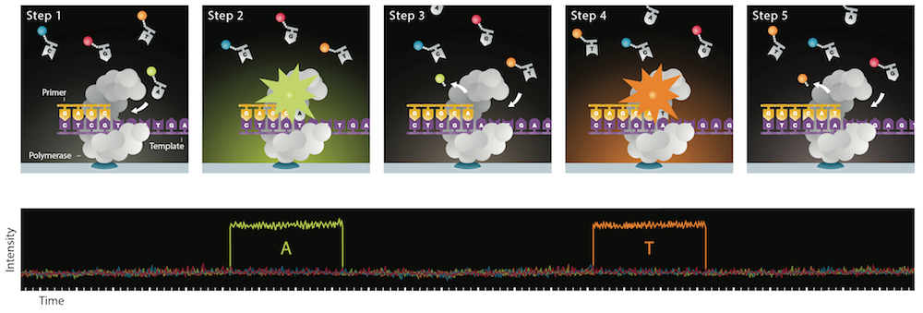
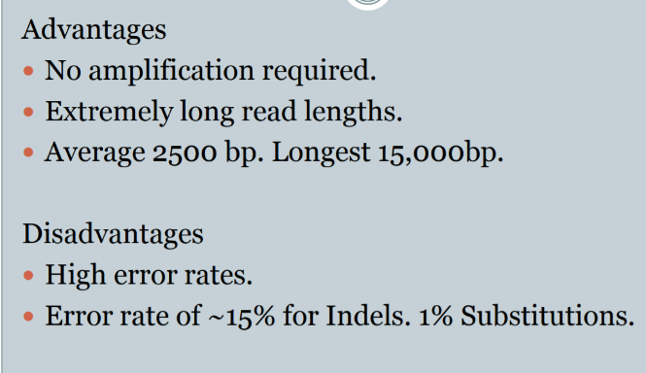
3rd generation – single molecule sequencing
PacBio
Nucleotide detection in a zero-mode waveguide (ZMW), as featured in PacBio sequencers. DNA polymerasemolecules are attached to the bottomofeach ZMW(*), and target DNA andfluorescent nucleotides are added. As the diameter is narrower than the excitation light'swavelength, illumination rapidly decays travelling up the ZMW: nucleotides being incorporated during polymerisation at the base of the ZMW provide real-time bursts offluorescent signal, without undue interference from other labelled dNTPs in solution.
https://youtu.be/NHCJ8PtYCFc

Slide 15
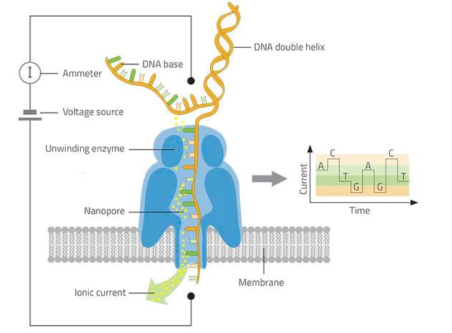
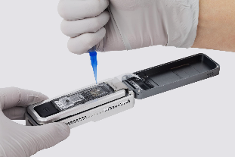
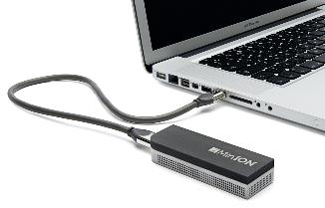
3rd generation Oxford Nanopore sequencing
https://youtu.be/CGWZvHIi3i0?t=24&end=55
Nanopore DNA sequencing as employed in ONT's MinION sequencer. Double stranded DNA gets denatured by a processive enzyme (†)which ratchets one of the strands through a biological nanopore (‡) embedded in a synthetic membrane, across which a voltage is applied. As the ssDNA passes through the nanopore the different bases prevent ionic flow in a distinctive manner, allowing the sequence of the molecule to be inferred by monitoring the current at each channel.
Still space for technological and algorithmic developments
DNA Sequencing via Quantum Mechanics and Machine Learning
https://arxiv.org/ftp/arxiv/papers/1012/1012.0900.pdf

Slide 16
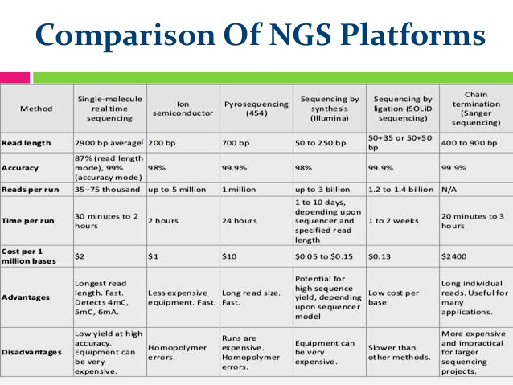

Slide 17
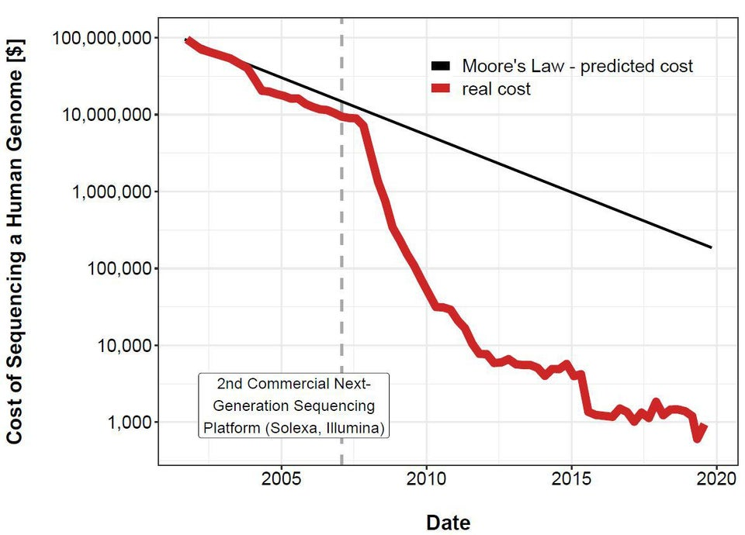
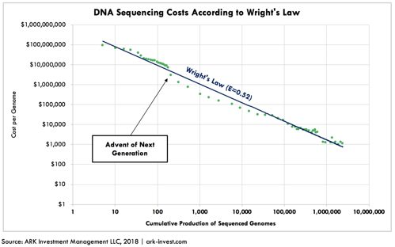
The cost of complete human genome sequencing
10000$
2007
1000$
2014
100$
2023

Slide 18
Sequencing quality control
Base calling, FASTQC

Slide 19
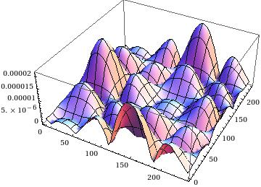

Base calling
A
G
C
T
1. Cluster identification by local maxima of intensity values
2. Background subtraction – noise removal
3. Correction for image shifts and scaling
Scaling
Cycle 1
Cycle 2
Cycle 1
Cycle 2
Shifts

Slide 20
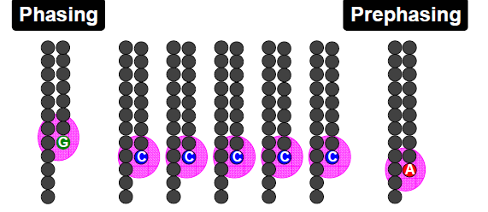
Other factors reducing quality
Cluster overlaps

Slide 21
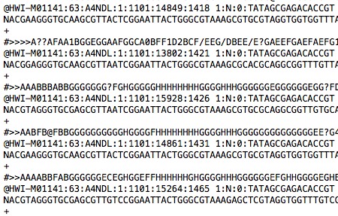
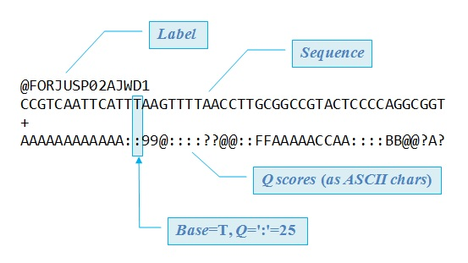
FASTQ format
The FASTQ format was invented at the turn of the century at the Wellcome Trust Sanger Institute by Jim Mullikin, gradually disseminated, but never formally documented (Antony V. Cox, Sanger Institute, personal communication 2009).

Slide 22
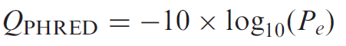
PHRED program
The PHRED software reads DNA sequencing trace files, calls bases and assigns a quality value to each base called (9,10).
P_{e} = probability of error
QUAL format: stores PHRED quality scores as integers
>SRR014849.1 EIXKN4201CFU84 length=93
GGGGGGGGGGGGGGGGCTTTTTTTGTTTGGAACCGAAAGGGTTTTGAATTTCAAACCCTTTTCGGTTTCCAACCTCCAAAGCAATGCCAATA
>SRR014849.1 EIXKN4201CFU84 length=93
18 10 5 3 2 1 1 1 1 1 1 1 1 1 1 1 22 37 31 22 16 11 6 1 26 34 30 11 33 26 30 21 33 26 25 36 32 16 36 32 16 36 32 20 6 24 33 25 30 25 2 24 36 32 15 35 31 17 36 32 20 6 25 29 20 30 25 4 32 26 32 23 32 26 30 24 33 26 35 31 14 28 27 30 22 28 24 27 17 32 23 28 28

Slide 23
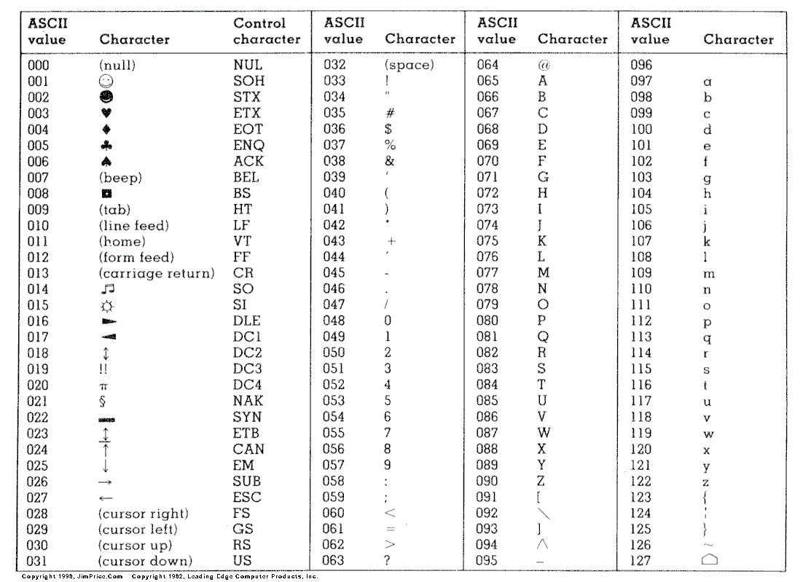
Stores PHRED scores as a single character:
ASCII space 33-126
=
PHRED scores 0-93
=
P_{e} in 1 - 10^{-9.3}

Slide 24
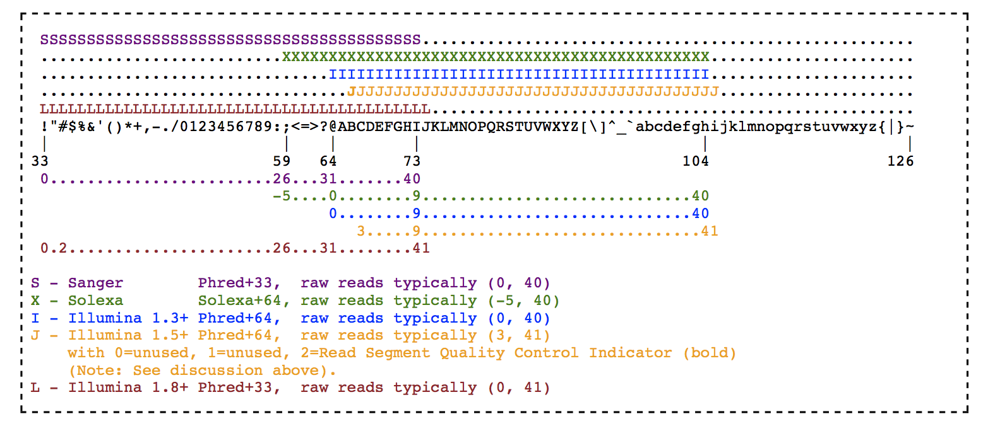
ASCII

Slide 25
Guess the quality score format
@SRR014849.1 EIXKN4201CFU84 length=93 GGGGGGGGGGGGGGGGCTTTTTTTGTTTGGAACCGAAAGGGTTTTGAATTTCAAACCCTTTTCGGTTTCCAACCTTCCAAAGCAATGCCAATA
+SRR014849.1 EIXKN4201CFU84 length=93 3+&$#"""""""""""7F@71,’";C?,B;?6B;:EA1EA1EA5’9B:?:#9EA0D@2EA5’:>5?:%A;A8A;?9B;D@/=<?7=9<2A8==
@NB501365:324:HJ3TJBGX9:1:11101:5605:1059 1:N:0:TTAGGC+NCAGAGNC
TCTGCNATGCATTATGCAACAGCTTCGGATTTGGAGGAGTTAACACATCTCTTCTCTTCA
+
AAAAA#EEEEEEEEEEEEAEEEEEEEEEEEEEEEEEEEEEE/EEEEEEEEEEEAEEEEEE
Which format does my fastq file contain?
Currently, it is on the bioinformatician to determine wcich quality score was used, but may sometimes lead to errors.
Note that the NCBI SRA makes all its data available as standard Sanger FASTQ files (even if originally from a Solexa/Illumina machine).

Slide 26
NCBI Sequence Read Archive
https://www.ncbi.nlm.nih.gov/sra
Try searching for “chimpanzee whole genome sequencing” and filter by sequencing technologies
Download the whole genome sequencing data from baker’s yeast (Saccharomyces cerevisiae):
https://www.ncbi.nlm.nih.gov/sra/SRX8430549[accn]
Use SRA toolkit to download the run number SRR11881059:
Instructions to install:
https://github.com/ncbi/sra-tools/wiki/02.-Installing-SRA-Toolkit
A test:
fastq-dump --stdout SRR11881059 | head -n 8
Downlaod and split the paired-end reads simultanously (--split-files), skip technical reads (--skip-technical), remove adapter sequences from reads (--clip) and gzip the output:
> fastq-dump \
--gzip SRR11881059 \
--skip-technical \
--dumpbase \
--split-files \
--clip \
Check the quality of the samples with FASTQC:
> mkdir fastqc
> fastqc fastq/* -o fastqc

Slide 27
Thank you
Next topics: fastqc (continued)
Genome assembly
Alignment

